Slide 1

A Comparative Study of Carbon Emission of Most Popular Dish in 10 Countries

Slide 2



Team Members

Slide 3


Under the Guidance of

Slide 4

Our earth started to rebel when the carbon in the atmosphere began to swell.

Slide 5
Table of Contents
Let’s start with the presentation

Slide 6
Sr.no | TOPICS
1 | Motivation of the study
2 | Objective of the study
3 | Abstract
4 | Literature review and References
5 | Materials and Methodology
6 | Results – To be presented in Review 3
7 | Conclusion and discussion of future scope – To be presented in Review 3

Slide 7
Motivation of Study
1
What drove us to do this study?

Slide 8
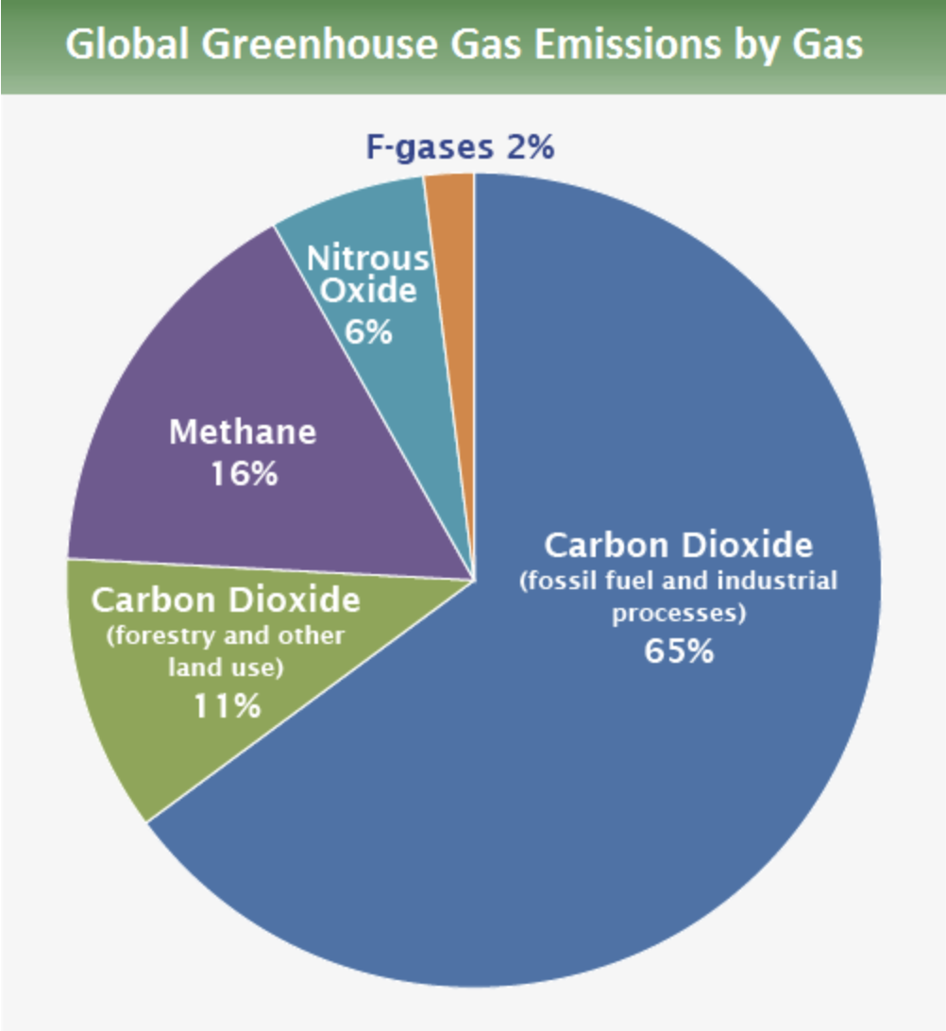
Human emissions of carbon dioxide and other greenhouse gases – are a primary driver of climate change – and present one of the world's most pressing challenges.¹
This link between global temperatures and greenhouse gas concentrations – especially CO₂ – has been true throughout Earth's history.²
Source: IPCC 2014

Slide 9
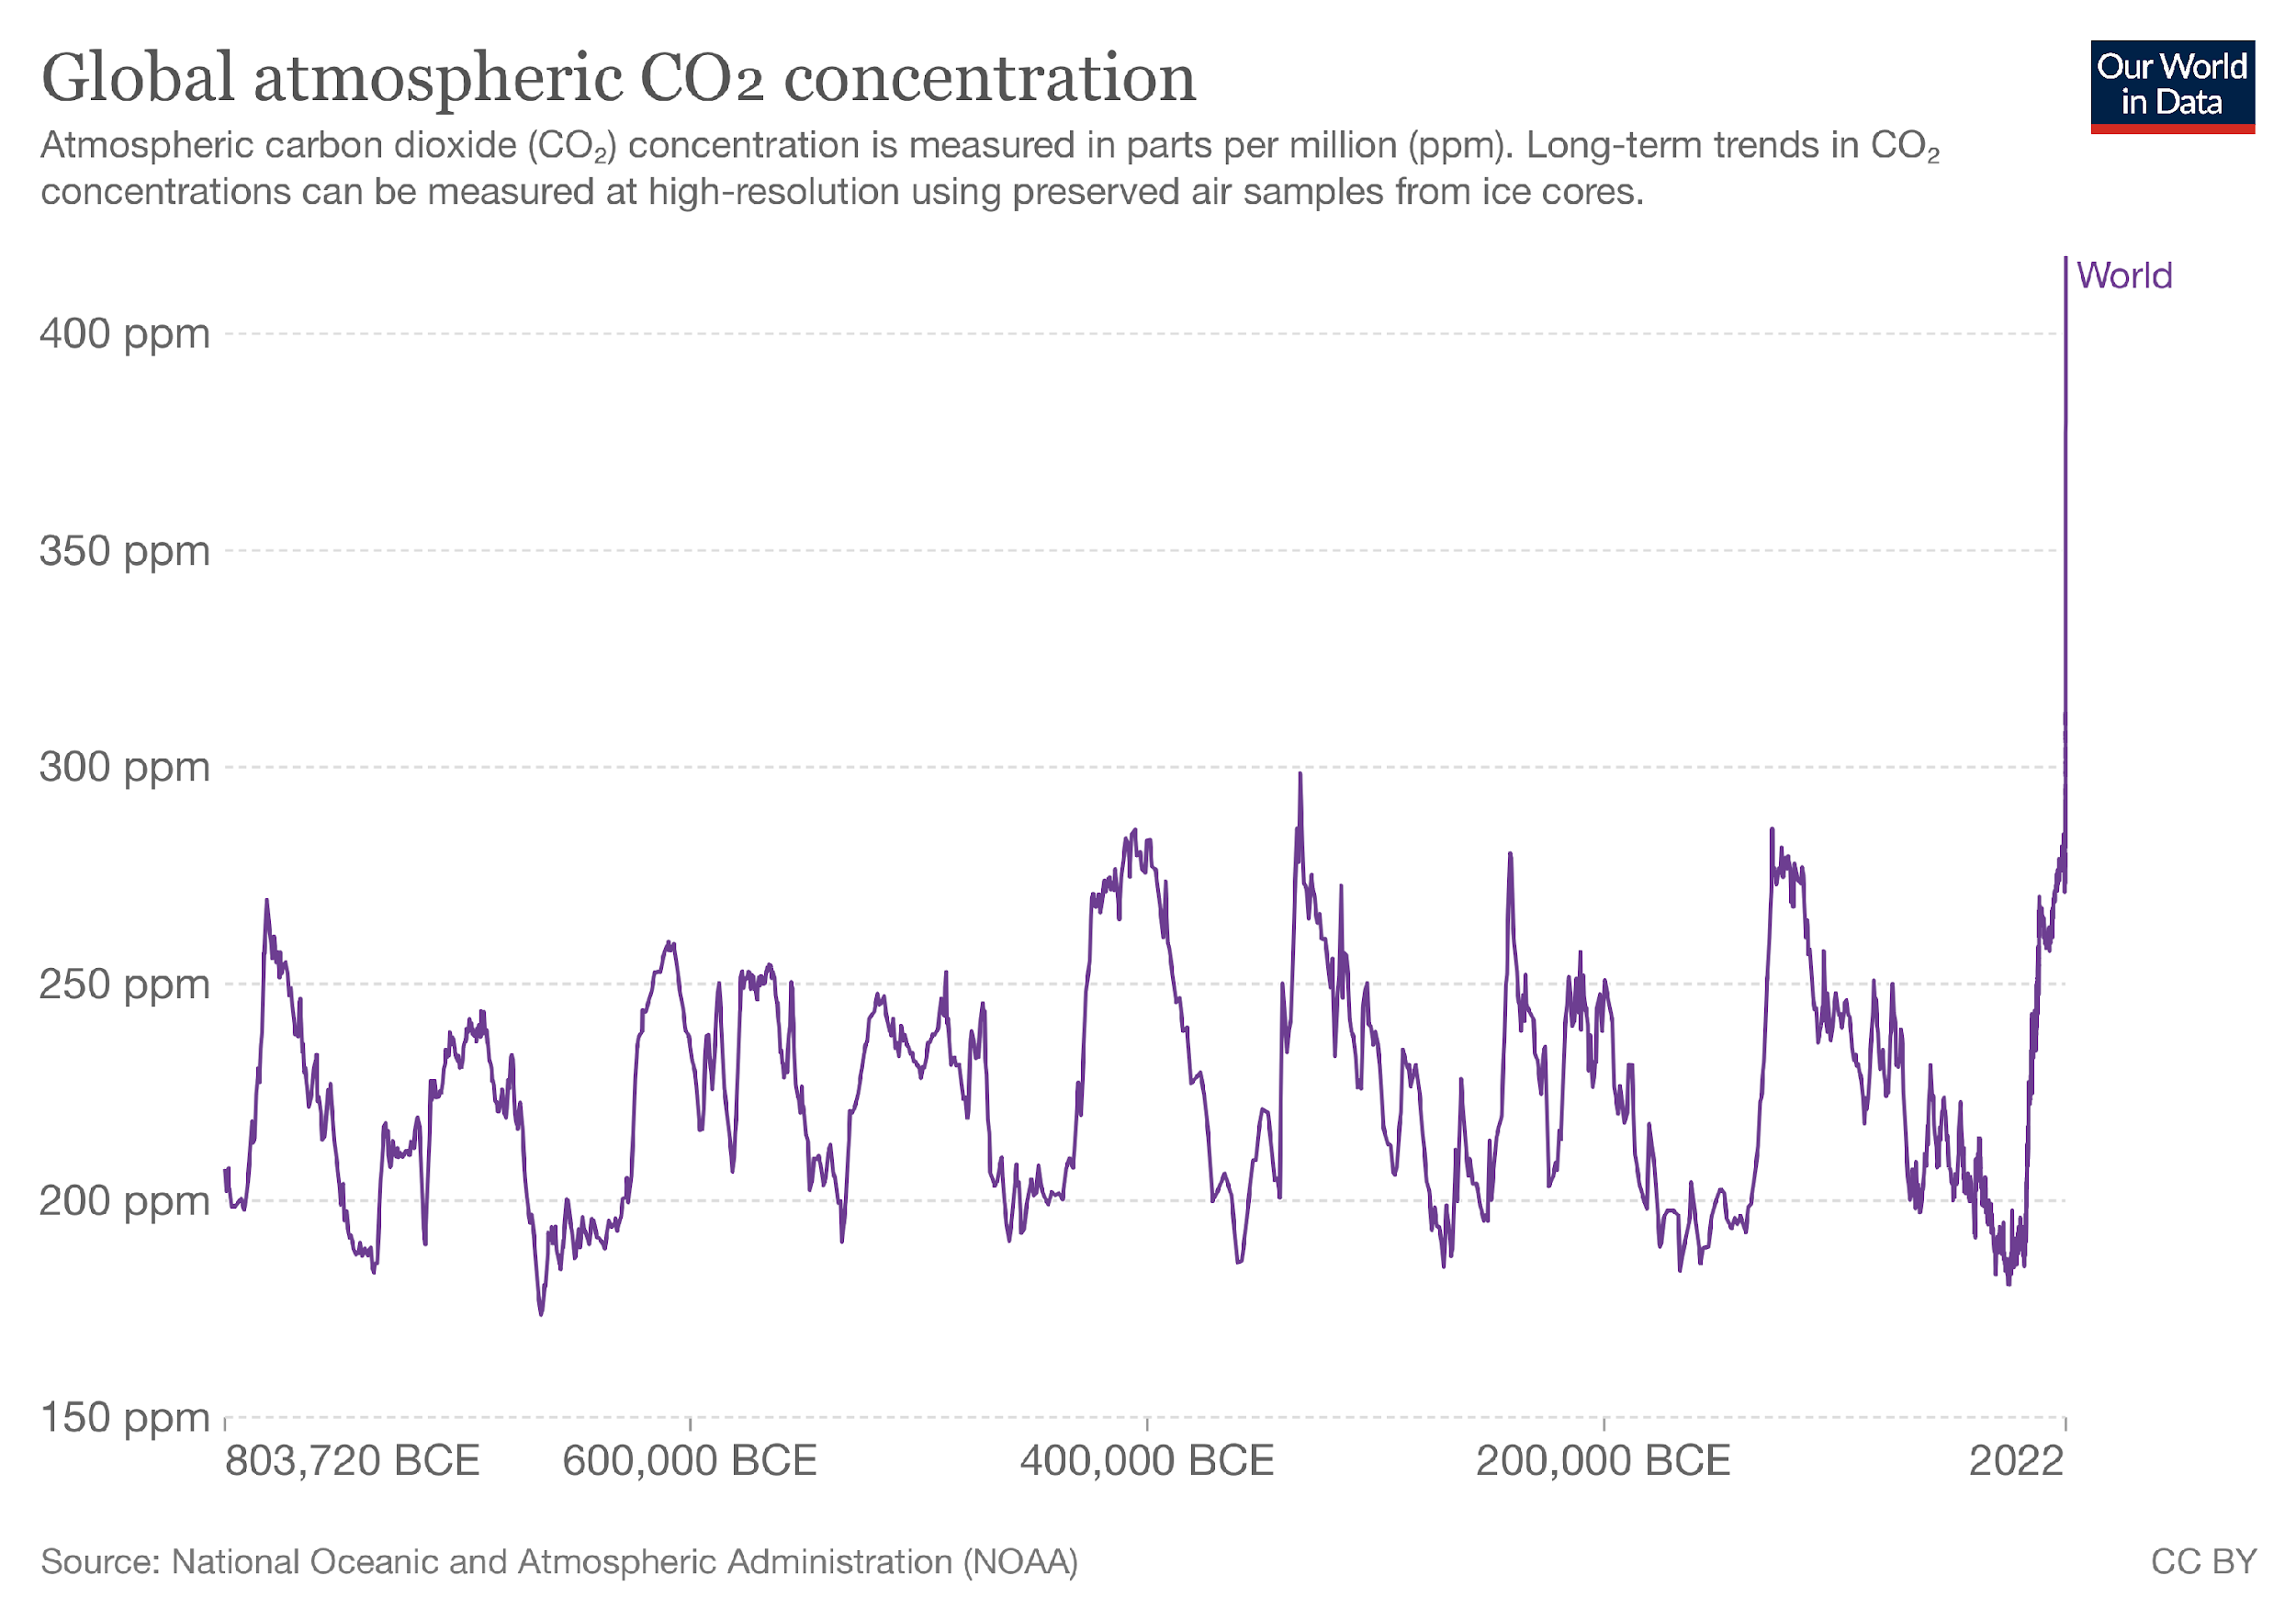
Source: Our World in Data

Slide 10
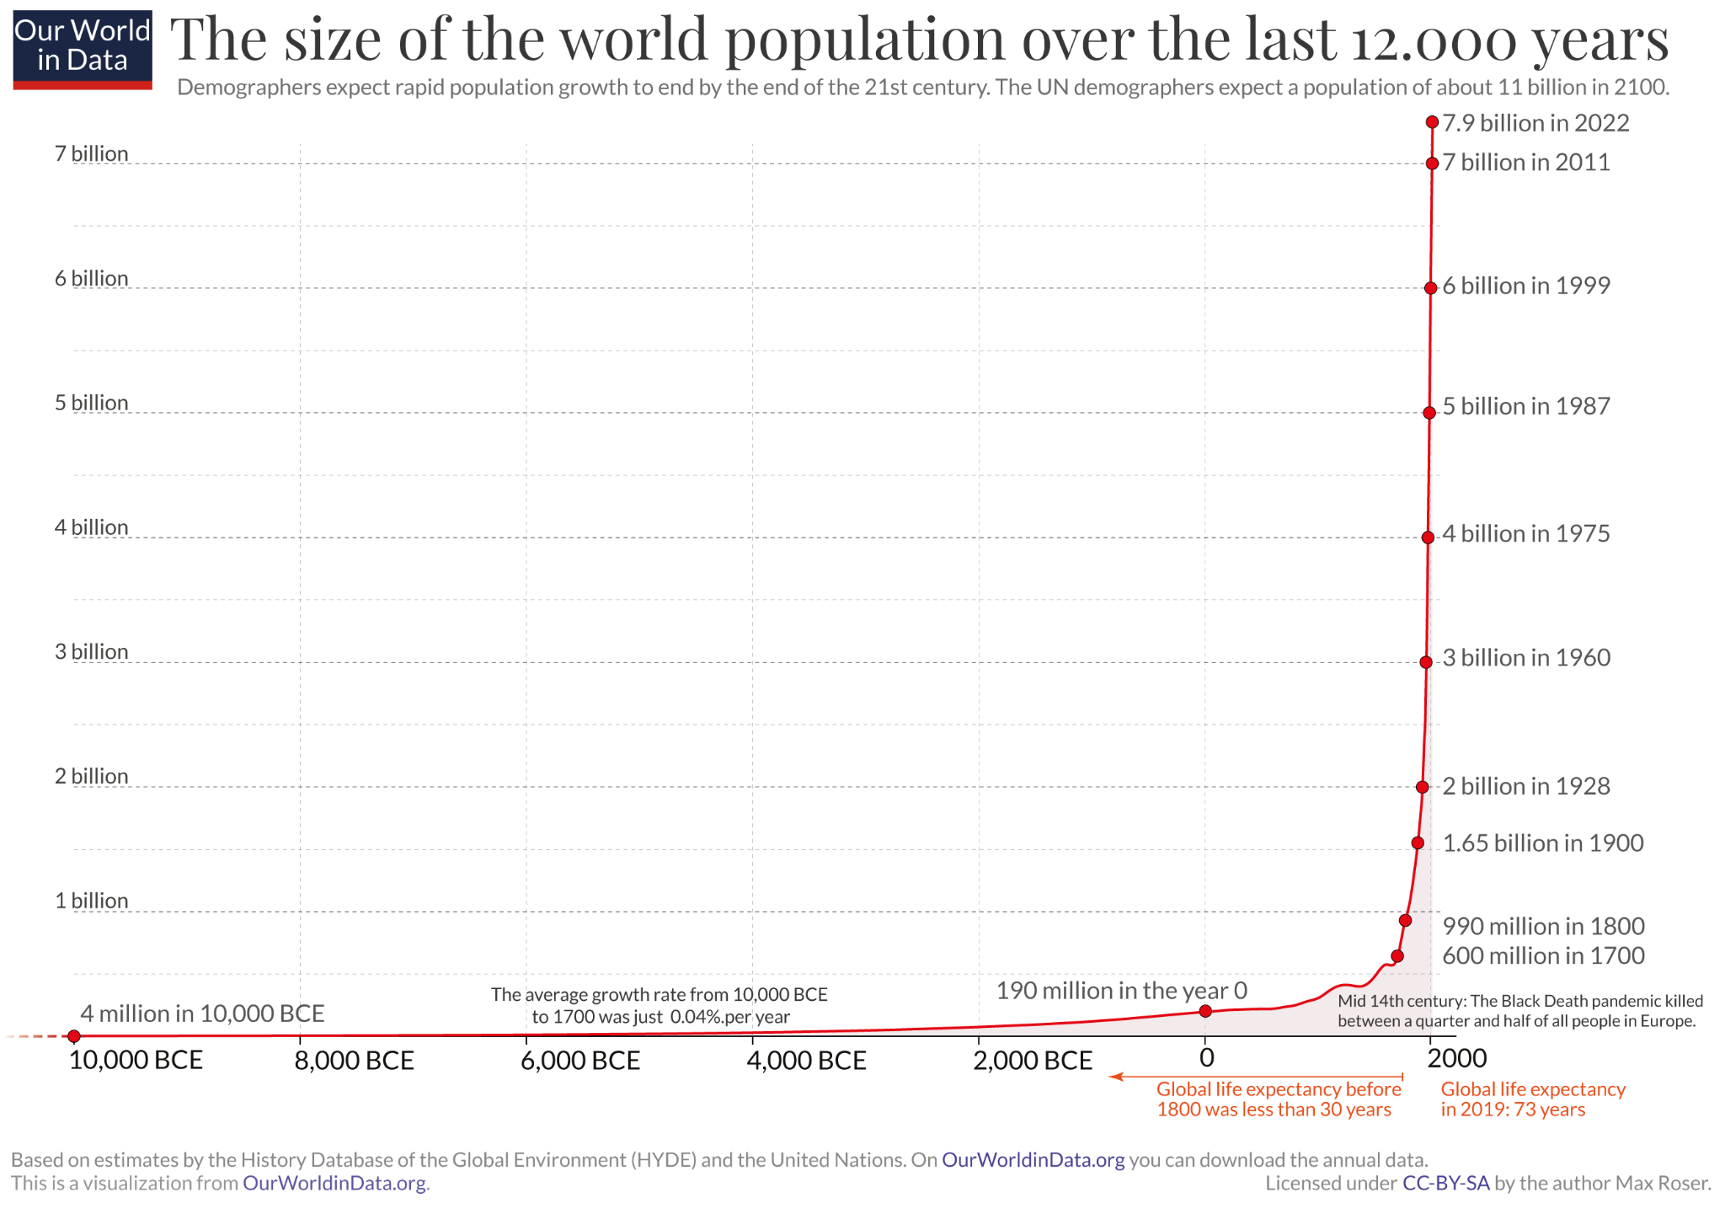
Source: Our World in Data

Slide 11
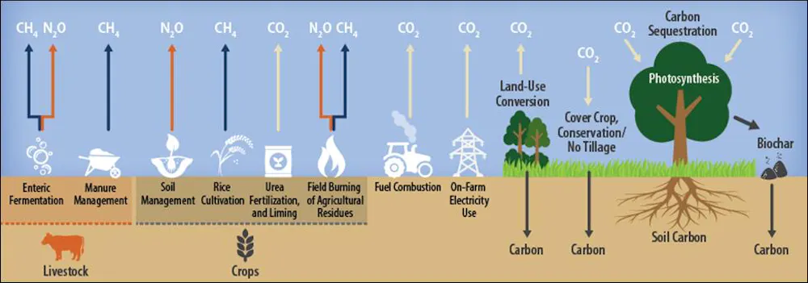
Food production generates more than a third (~35%) of manmade greenhouse gas emissions³
Source: The Conversation

Slide 12
Objective of Study
2
What do we intend to achieve with this study?

Slide 13
To identify the most consumed food in 10 countries** and to estimate the Carbon Emission caused by them
To observe the relationship between dietary habits and Carbon Footprint and hence compare among the 10 chosen countries
To draw a conclusion and hence encourage climate-conscious choices with respect to dietary patterns
**Selection of countries based on the criteria that they have a high population density

Slide 14
Abstract
3
A brief synopsis

Slide 15
Carbon emission occurs during various stages of the life cycle of food products. This research aims at doing a comparative study of the total carbon emission at all stages caused due to the most consumed dishes in 10 countries**. By doing this comparison, we aim to categorize the countries as per their carbon emission and find out about the country with the most carbon-conscious dietary choices. The large scale of the food industry makes emission reduction in the industry very important.
The countries were chosen based on the fact that: they have huge and comparable population densities. Dishes were chosen based on consumption by the majority of the population of that particular country.
A vast data set obtained from ‘Kaggle’ and ‘Our World in Data’ is to be used as our data set. Information was extracted from the data sets to calculate and compare the most consumed food of the chosen 10 countries. Tools used for this data analysis project are excel (for data sets and calculations) and python (for plotting and comparisons).
Further scope of this project was also discussed. Key Words: Data Analysis, Carbon emission, Countries, Most consumed dishes
** India, USA, China, Bangladesh, Mexico, Russia, Indonesia, Pakistan, Nigeria, Brazil

Slide 16
Literature Review and References
4
A deep dive into the researches undertaken before

Slide 17
Annika Carlsson-Kanyama; Alejandro D González Potential contributions of food consumption patterns to climate change The American Journal of Clinical Nutrition, Volume 89, Issue 5, May 2009, Pages 1704S–1709S, DOI: 10.3945/ajcn.2009.26736AAA
Rosemary F. Green; Edward J.M. Joy; Francesca Harris
Greenhouse gas emissions and water footprints of typical dietary patterns in India
Science of The Total Environment, Volume 643,2018, Pages 1411-1418, ISSN 0048-9697,
DOI: 10.1016/j.scitotenv.2018.06.258
A study of how food consumption patterns contribute to climate change was done. It found that certain foods, such as beef and pork, have high greenhouse gas emissions due to production methods. In contrast, foods like vegetables and fruits have lower emissions.
Hence, it can be suggested that changes to our diet such as eating more plant-based foods and choosing meat from animals that don't produce methane can help reduce emissions and mitigate climate change. It can hence be concluded that the way we consume food has an impact on the environment, and understanding this relationship is important.
India's agricultural sector has a significant impact on the environment, especially in terms of greenhouse gas (GHG) emissions from livestock and freshwater required for irrigation.
Future efforts by agriculture to keep up with India's expanding population and shifting food habits are anticipated to increase these effects. India has a wide variety of food practices and hence varies in the GHG emissions and water use resulting from various dietary practices. To examine the food habits of 10 different nations, we utilised a similar methodology.

Slide 18
Joya A. Kemper, Maureen Benson-Rea, Jenny Young, Miriam Seifert,
Cutting down or eating up: Examining meat consumption, reduction, and sustainable food beliefs, attitudes, and behaviors
Food Quality and Preference,Volume 104,2023,104718,ISSN 0950-3293,
DOI: /10.1016/j.foodqual.2022.104718
Ziyue Yu, Sijian Jiang, Ali Cheshmehzangi, Yu Liu, Xiangzheng Deng,
Agricultural restructuring for reducing carbon emissions from residents' dietary consumption in China
Journal of Cleaner Production,Volume 387,2023,35948,ISSN 0959-6526,
DOI: 10.1016/j.jclepro.2023.135948
The research examines the attitudes and behaviors of individuals who reduce their meat consumption due to health, environmental, ethical, and cost concerns. The study uses an online survey to compare meat eaters, meat reducers, and occasional meat eaters in terms of their meat consumption and reasons for and against meat reduction. The research finds that lamb and pork consumption is the only factor that differs significantly between the dietary groups, while beef and chicken consumption is similar among meat eaters and reducers.
The research concludes that a comprehensive understanding of meat consumption and reduction preferences, attitudes, and beliefs is important for providing targeted marketing and social marketing strategies aimed at encouraging more sustainable and healthy food behaviors i.e. making Carbon conscious choices
China has committed to achieving peak carbon by 2030 and carbon neutrality by 2060. However, this requires a significant reduction in carbon emissions. The present study examines ways to reduce carbon emissions through food consumption, climate change, and agricultural structure. It design future scenarios based on widely used SSP storyline. The study finds that replacing red meat with plant foods such as vegetables and fruits will have a more significant carbon reduction potential.
Reducing meat and high-fat foods consumption may help reduce GHG emissions produced by food consumption and promote green agriculture development.

Slide 19
Dr Surendra Pathak; Niveta Jain; Arti Bhatia; Patel J; P.K. Aggarwal
Carbon footprints of Indian food Items
Agriculture Ecosystems & Environment 139(1-2):66-73, October 2010
DOI: 10.1016/j.agee.2010.07.002
Klaas Jan Kramer; Henri C Moll; Sanderine Nonhebel; Harry C Wilting,
Greenhouse gas emissions related to Dutch food consumption,
Energy Policy, Center for Energy and Environmental Studies, University of Groningen, Nijenborgh 4,9747 AG Groningen, Netherlands, April 1999,
DOI: 10.1016/S0301-4215(99)00014-2
Carbon emission occurs during various stages of the life cycle of food products. GHG emissions from 24 Indian food items showed that animal food products and rice cultivation mostly contributed to methane (CH4) emissions.
Emission of CO2 occurred during farm operations,
production of farm inputs, transport, processing and preparation of food. The GHG emission during the life cycle of cooked rice was 2.8 times the GHG emission during the life cycle of chapatti, a product of wheat flour. Mutton emitted 11.9 times as much GHG as milk, 12.1 times as fish, 12.9
rice and 36.5 times chapatti. As Indians mostly consume fresh foods produced locally, 87% of emissions came from food production followed by preparation (10%), processing (2%) and transportation (1%). Change in food habits thus could offer a possibility for GHG mitigation.
A similar study was done in the Netherlands to analyse the emissions of greenhouse gases produced by Dutch households in their food consumption.
The authors found that certain types of food, specifically those from cattle farming and agriculture, were major sources of emissions. The study suggests that these findings can inform potential reductions in emissions by identifying which food products have higher emissions and their potential reduction options which is along similar lines to the study that is undertaken by us

Slide 20
Prosper Ebruvwiyo Edoja; Goodness C. Aye & Orefi Abu | Caroline Elliott (Reviewing Editor) (2016)
Dynamic relationship among CO2 emission, agricultural productivity and food security in Nigeria,
Cogent Economics & Finance, 4:1,
DOI: 10.1080/23322039.2016.1204809
Ahmad, Ishfaq; Akbar, Muhammad; Noor, Farzana; A.Sattar
Impact of energy consumption and CO2 emissions on food production in Pakistan: An econometric analysis
Pakistan Journal of Agricultural Research 55(2), May 2018.
DOI: 10.21162/PAKJAS/18.6703
A study along the aforementioned lines was undertaken by Nigeria wherein a relationship between C02 emission, agricultural productivity and food security was tried to be established.
A cyclic relationship nature was found– agriculture and food production cause Carbon Emissions. Damage from the consumption of toxic emissions from CO2 by the surrounding vegetation can affect the quality and aesthetic value of plants and reduce their economic value. When CO2 sinks in the atmosphere, the resulting water can become harmful to vegetation and aquatic life.
Taking our neighbour Pakistan into account. Pakistan with 2.5% of the world's population, is a food-insecure country. Vision 2050 of UNO emphasizes the doubling of world food production to achieve food security.
Pakistan requires effective policies to meet the targets of UN Vision 2050. Analysing the impact of some important factors on food production may be helpful to achieve sufficient food production in Pakistan. Pakistan is hence working on developing a model which increases food production to become a food-secure country without compromising on CO2 and Greenhouse Gases Emission.

Slide 21
Materials and Methodology
5
A discussion on the data-sets and working done

Slide 22
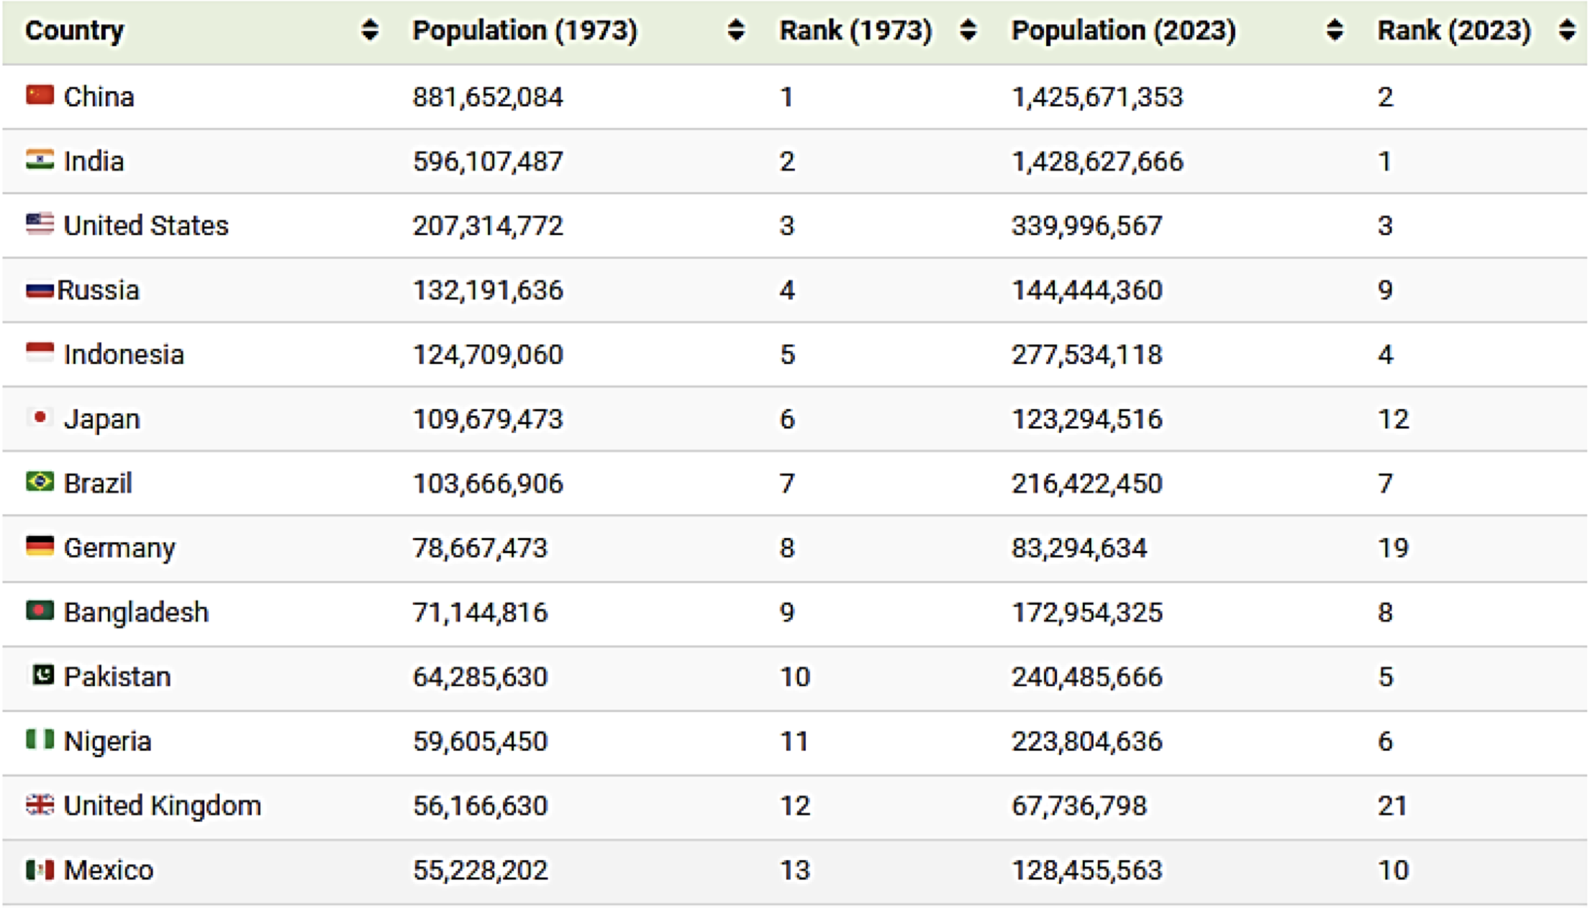
A. Study Area
Selection of Country:
As per the reports, published in the Visual Capitalist titled “Charted: The World’s Most Populous Countries (1973–2023)”, we selected 10 countries which are predicted to be in the top 10 in terms of population by 2023.
Source: Visual Capitalist

Slide 23
Russia
United States of America
China
Pakistan
Bangladesh
Mexico
India
Nigeria
Indonesia
Brazil

Slide 24
B. Data Collection Procedure
The primary data for this investigation has been prepared by using the vast amount of data present in the internet.
We identified the most consumed/popular dish in each of the 10 selected countries.
Using the standard recipes of those selected dishes, we noted down the amount of main ingredients each, that are needed to make one standard serving for an adult.
Sr.no. | Countries | Dishes | Source
1 | China | Yangzhou fried rice | China highlights
2 | India | Vegetable curry, chapati | The spruce eats
3 | United States | Burgers, Fries | Micro b life
4 | Indonesia | Nasi Goreng | CNN
5 | Pakistan | Pakistani nihari | FOOD52
6 | Nigeria | Jollof Rice | Will fly for food
7 | Brazil | Feijoada with rice | Rainforest cruises
8 | Bangladesh | Fish curry with rice | Together women rise
9 | Russia | Pelmeni | trip savvy
10 | Mexico | Tacos | Taste atlas
Table B(a): Most consumed/popular dishes of 10 countries

Slide 25
Sr.no | Dishes | Ingredients | Source
1 | Yangzhou fried rice | Rice, prawns, egg, vegetables, oil, ham(pork) | https://www.madewithlau.com/recipes/yangzhou-fried-rice
2 | Vegetable curry, chapati | Wheat, vegetable, onion, tomato, potato, oil | https://www.bongeats.com/recipe/roti https://www.slurrp.com/recipes/mixed-veg-1611367030
3 | Burgers, Fries | Wheat, Beef, Tomato, Onion, Potatoes, Cheese | https://www.slurrp.com/recipes/mixed-veg-1611367030
4 | Nasi Goreng | Rice, oil, chicken, eggs, onions | https://www.recipetineats.com/nasi-goreng-indonesian-fried-rice/
5 | Pakistani nihari | Beef, oil, onions, wheat | https://samarascuisine.com/nihari-recipe/
6 | Jollof Rice | Rice, chicken, onion | https://www.slurrp.com/recipes/jollof-rice-1623823191
7 | Feijoada with rice | Onion, tomatoes, olive oil, rice, pork, beans | https://www.curiouscuisiniere.com/feijoada-brazilian-black-bean-stew/
8 | Fish curry with rice | Rice, fish, radish, onion | https://www.slurrp.com/recipes/bangladesh-fish-curry-recipe-1622791817
9 | Pelmeni | Wheat, eggs, beef, pork, onion | https://www.thekitchn.com/pelmeni-recipe-23058710
10 | Tacos | Beef, tomatoes, wheat, cheese | https://www.bettycrocker.com/recipes/easy-beef-tacos/426c261d-b2eb-4e22-9cba-0066f3335591
Table B(b): Main ingredient of each dish

Slide 26
Sr.no | Dishes | Ingredients (per kg)
1 | Yangzhou fried rice | Rice | Prawns | Eggs | Vegetables | Oil | Ham(pork)
 |  | 0.06167 | 0.0227 | 0.0224 | 0.0226 | 0.009 | 0.0283
2 | Vegetable curry, chapati | Wheat | Vegetable | Onions | Tomato | Potato | Oil
 |  | 0.08 | 0.214 | 0.075 | 0.075 | 0.075 | 0.0075
3 | Burgers, Fries | Wheat | Beef | Tomato | Onions | Potatoes | Cheese
 |  | 0.105 | 0.151195945 | 0.02918 | 0.02918 | 0.0850486 | 0.04
4 | Nasi Goreng | Rice | Oil | Chicken | Eggs | Onions | -
 |  | 0.135 | 0.0085 | 0.0375 | 0.005 | 0.075 | -
5 | Pakistani nihari | Beef | Oil | Onions | Wheat | - | -
 |  | 0.1135 | 0.0283 | 0.0625 | 0.0071 | - | -
6 | Jollof Rice | Rice | Chicken | Onions | - | - | -
 |  | 0.05625 | 0.0435 | 0.078599053 | - | - | -
7 | Feijoada with rice | Onions | Tomato | Olive oil | Rice | Pork | Beans
 |  | 0.03144 | 0.0085 | 0.0143 | 0.167 | 0.0567 | 0.0453592
8 | Fish curry with rice | Rice | Fish | Radish | Onions | - | -
 |  | 0.4 | 0.075 | 0.075 | 0.00017 | - | -
9 | Pelmeni | Wheat | Eggs | Beef | Pork | Onions | -
 |  | 0.0375 | 0.0005 | 0.011339 | 0.011339 | 0.014174 | -
10 | Tacos | Beef | Tomato | Wheat | Cheese | - | -
 |  | 0.045 | 0.0226796 | 0.04166667 | 0.0113398 | - | -
Table B(c): Portion size of ingredients per capita for one serving

Slide 27
A standard data set from Kaggle named Food_Product_Emission from EDGAR. (EDGAR is the Emission Database for Global Atmospheric Research and EDGAR-FOOD is a global emission inventory of GHGs from food systems)
This data set consists of information on CO2 per kg produced by the most common food. Each food product is listed with global average GHG emissions from each stage of the food value chain from Land, Farm, Animal feed, Processing, Transport, and Packaging to Retail. (Note that it excludes the global average GHG emissions for Consumer or Waste stages of global food systems)

Slide 28


C. Data Analysis approach
Data for the study were generated and analysed in Microsoft Excel using distribution tables with simple measurements and introspectively using mathematical models for the computation of carbon emission of food consumption.
Visualization is done using python programming.
Source: Unknown Authors

Slide 29
D. Estimation of Carbon Emission
From the empirical survey through various websites, the main ingredients of the dishes have been determined.
To estimate the weight of each ingredient the standard recipes are taken into consideration, accounting for the portion size to be per capita.
The weights were converted into kilograms for the suitable calculation of CO2 emission per kg of food items.
Computation of CO2 emission is initiated by multiplying the total global average(mean) GHG with the weights of each item
Furthermore, we take the summation of the derived values for each of the dishes which concludes the carbon emission for the particular dish of the country.

Slide 30
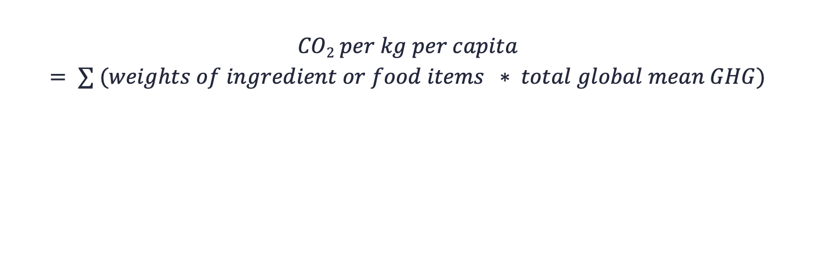
The equation for the estimation of carbon emission is as follows:
Source:

Slide 31
Results
6
An understandings of the outcomes of our study

Slide 32
A. Carbon Emission Per Capita
Sr.no | Dishes | Ingredients (per kg)
1 | Yangzhou fried rice | Rice | Prawns | Eggs | Vegetables | Oil | Ham(pork)
 |  | 0.2744315 | 0.609949 | 0.104608 | 0.011978 | 0.0324 | 0.348373
2 | Vegetable curry, chapati | Wheat | Vegetable | Onions | Tomato | Potato | Oil
 |  | 0.1256 | 0.11342 | 0.0375 | 0.15675 | 0.0345 | 0.027
3 | Burgers, Fries | Wheat | Beef | Tomato | Onions | Potatoes | Cheese
 |  | 0.16485 | 15.0409726 | 0.0609862 | 0.01459 | 0.039123 | 0.9552
4 | Nasi Goreng | Rice | Oil | Chicken | Eggs | Onions | -
 |  | 0.6007 | 0.0306 | 0.370125 | 0.02335 | 0.0375 | -
5 | Pakistani nihari | Beef | Oil | Onions | Wheat | - | -
 |  | 11.29098 | 0.10188 | 0.03125 | 0.011147 | - | -
6 | Jollof Rice | Rice | Chicken | Onions | - | - | -
 |  | 0.2503125 | 0.42935 | 0.0392995 | - | - | -
7 | Feijoada with rice | Onions | Tomato | Olive oil | Rice | Pork | Beans
 |  | 0.0812 | 0.017765 | 0.077506 | 0.74315 | 0.697977 | 0.081192968
8 | Fish curry with rice | Rice | Fish | Radish | Onions | - | -
 |  | 1.78 | 1.02225 | 0.03225 | 0.000085 | - | -
9 | Pelmeni | Wheat | Eggs | Beef | Pork | Onions | -
 |  | 0.0375 | 0.002335 | 1.12800372 | 0.13958309 | 0.007085 | -
10 | Tacos | Beef | Tomato | Wheat | Cheese | - | -
 |  | 4.4766 | 0.047400364 | 0.06541719 | 0.27077532 | - | -
The equation is used to find emission CO2 per products used

Slide 33
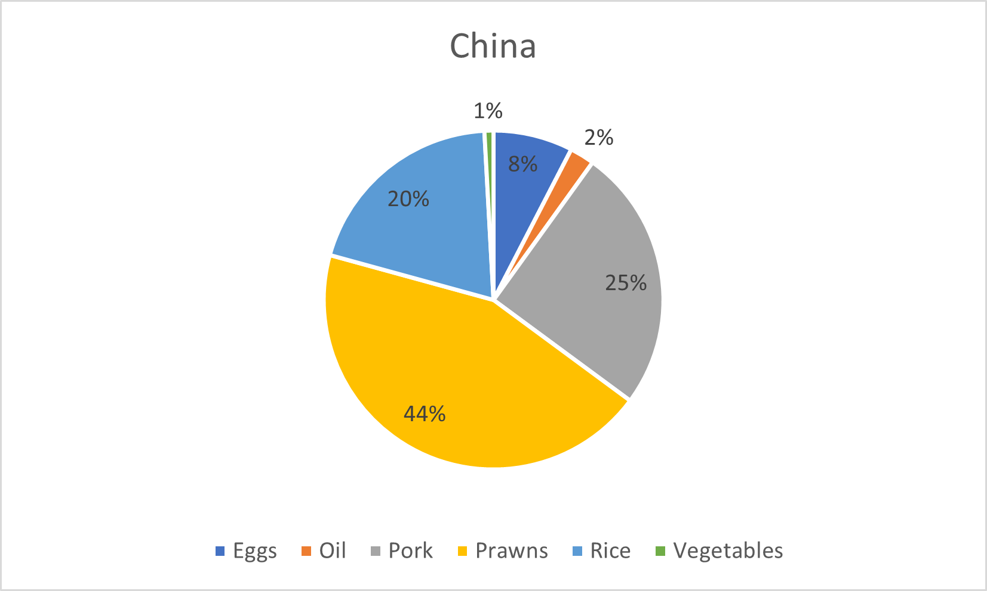
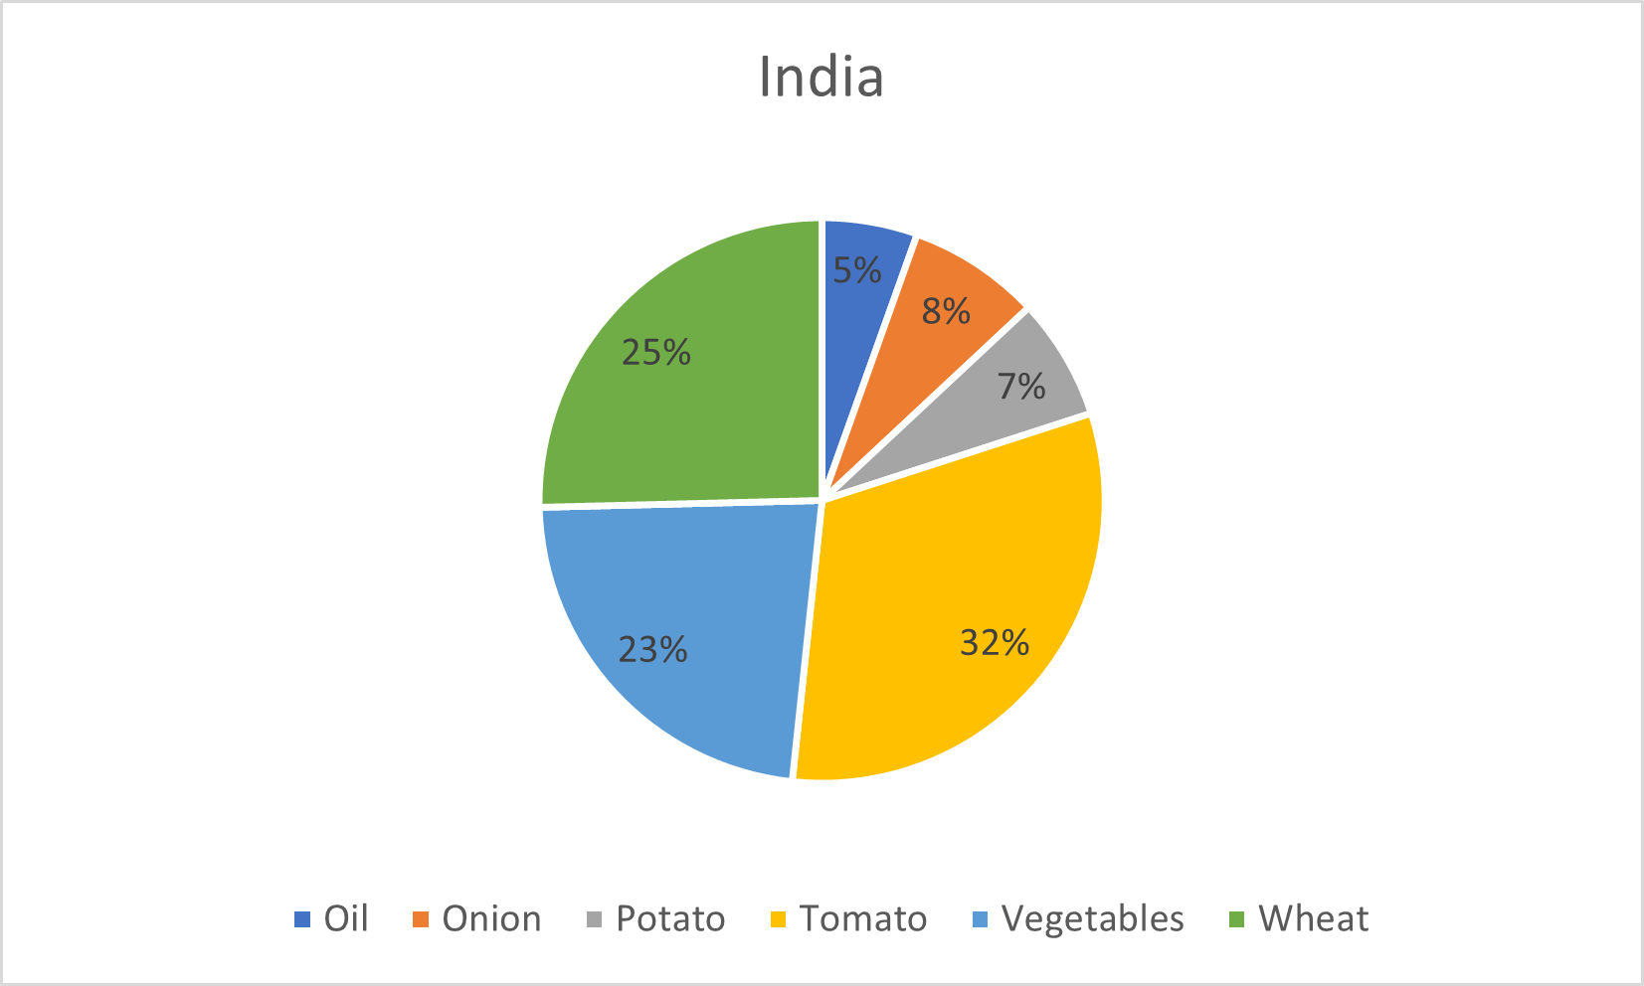
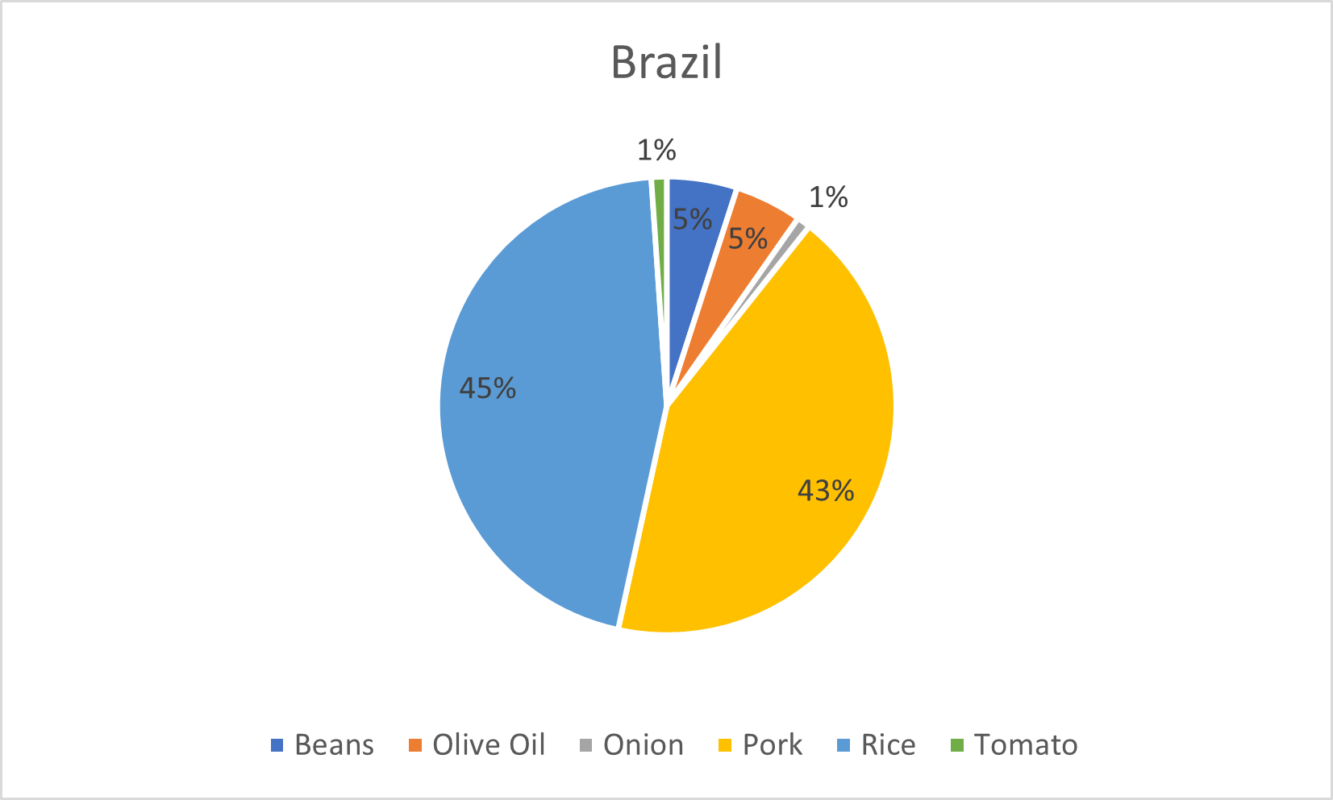
B. Country-wise fraction of Emission
By comparing the plots we can see that the Rice would emit more CO2 than Wheat based products.

Slide 34
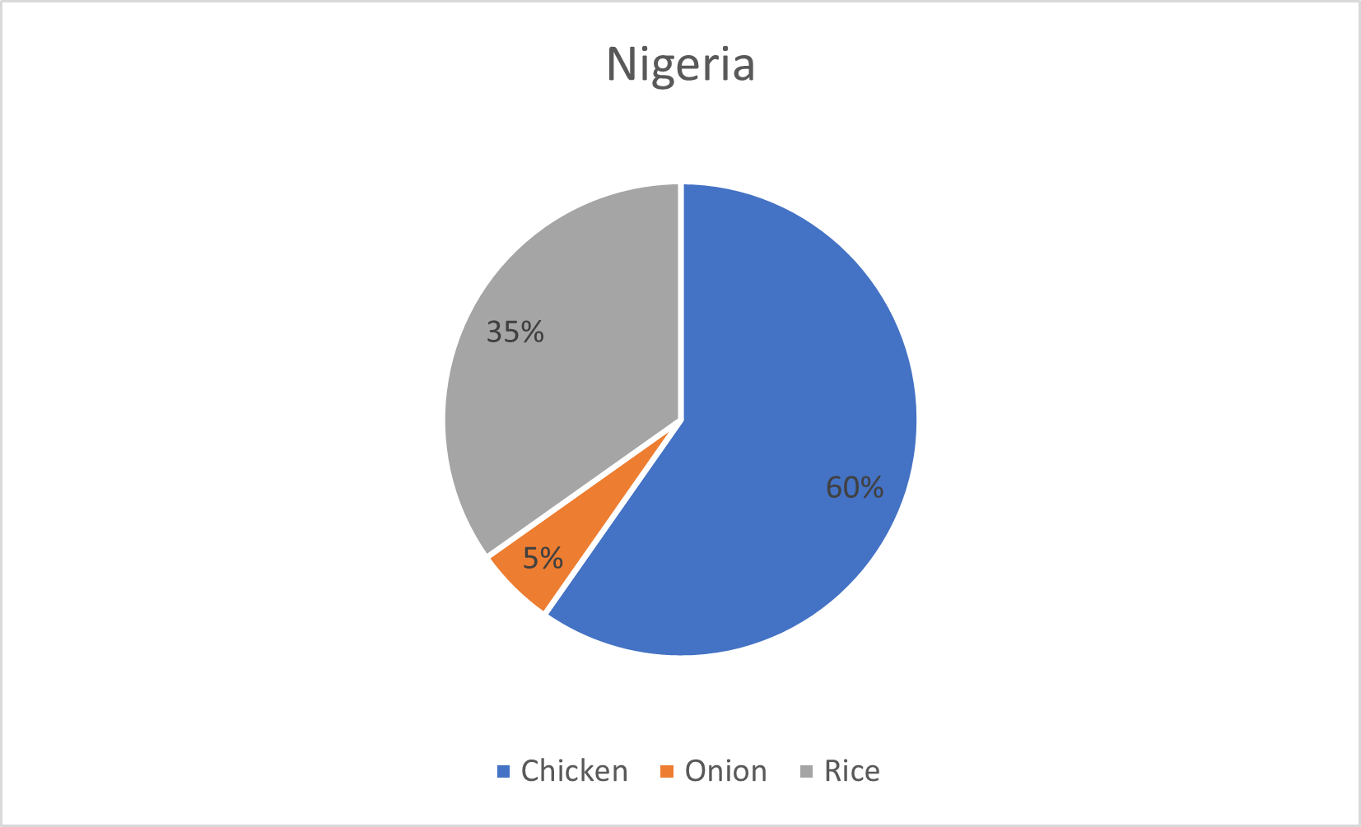
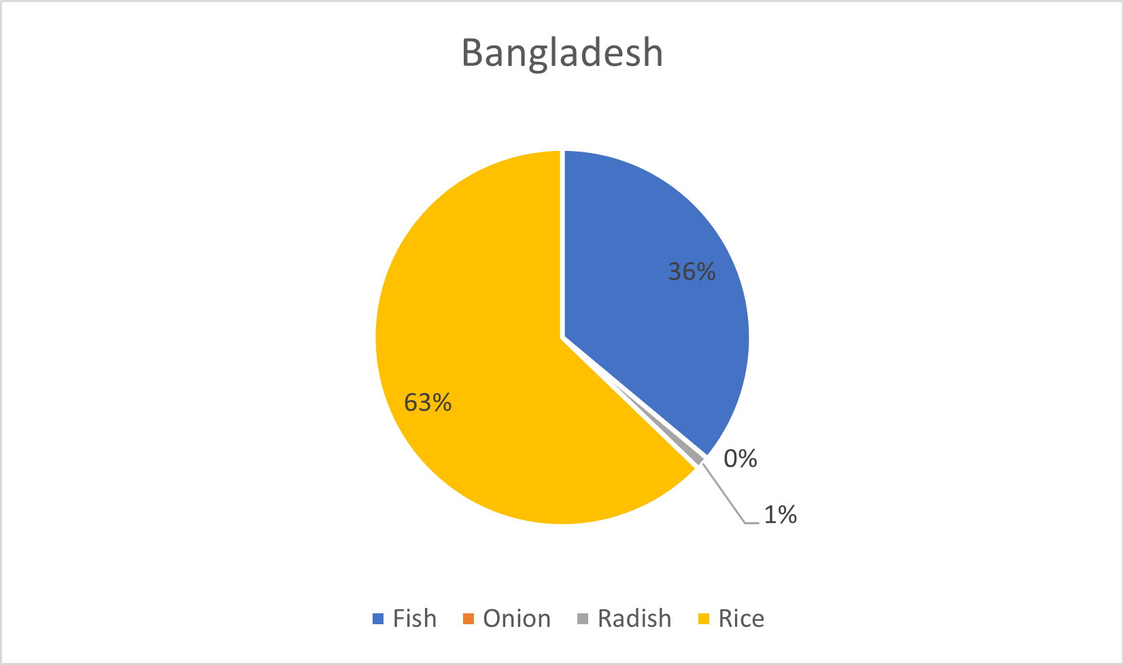
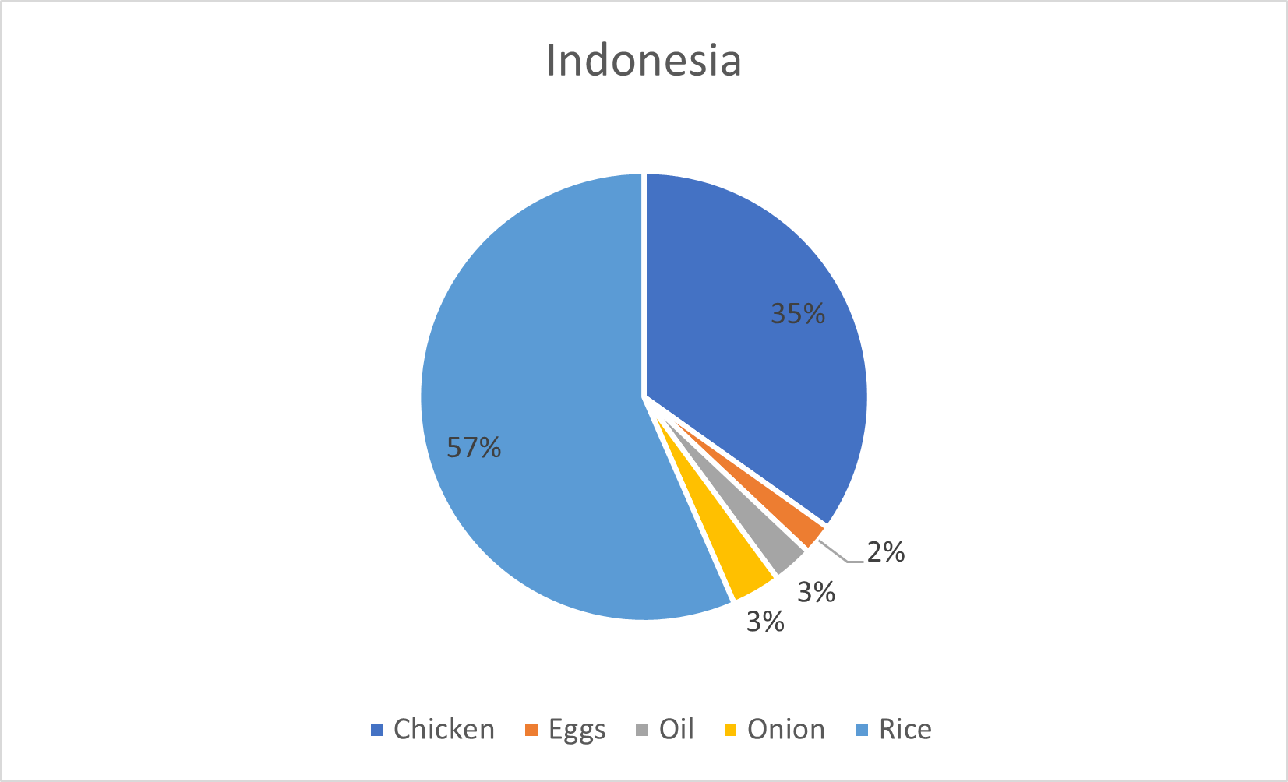
In the Nigerian Dish Jollof Rice, the weight of rice is almost same, but the emission caused by chicken is almost double.
The same trend is seen in the Indonesian dish Nasi Gerong.

Slide 35
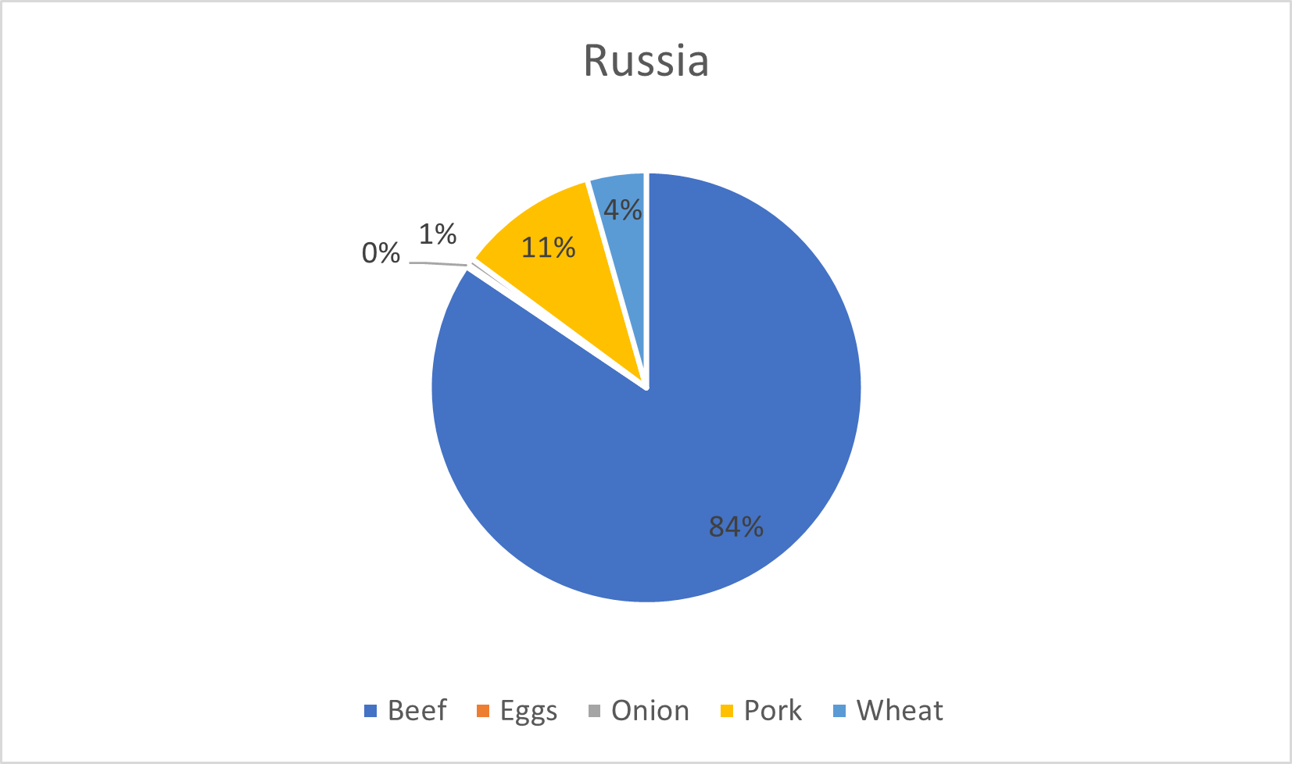
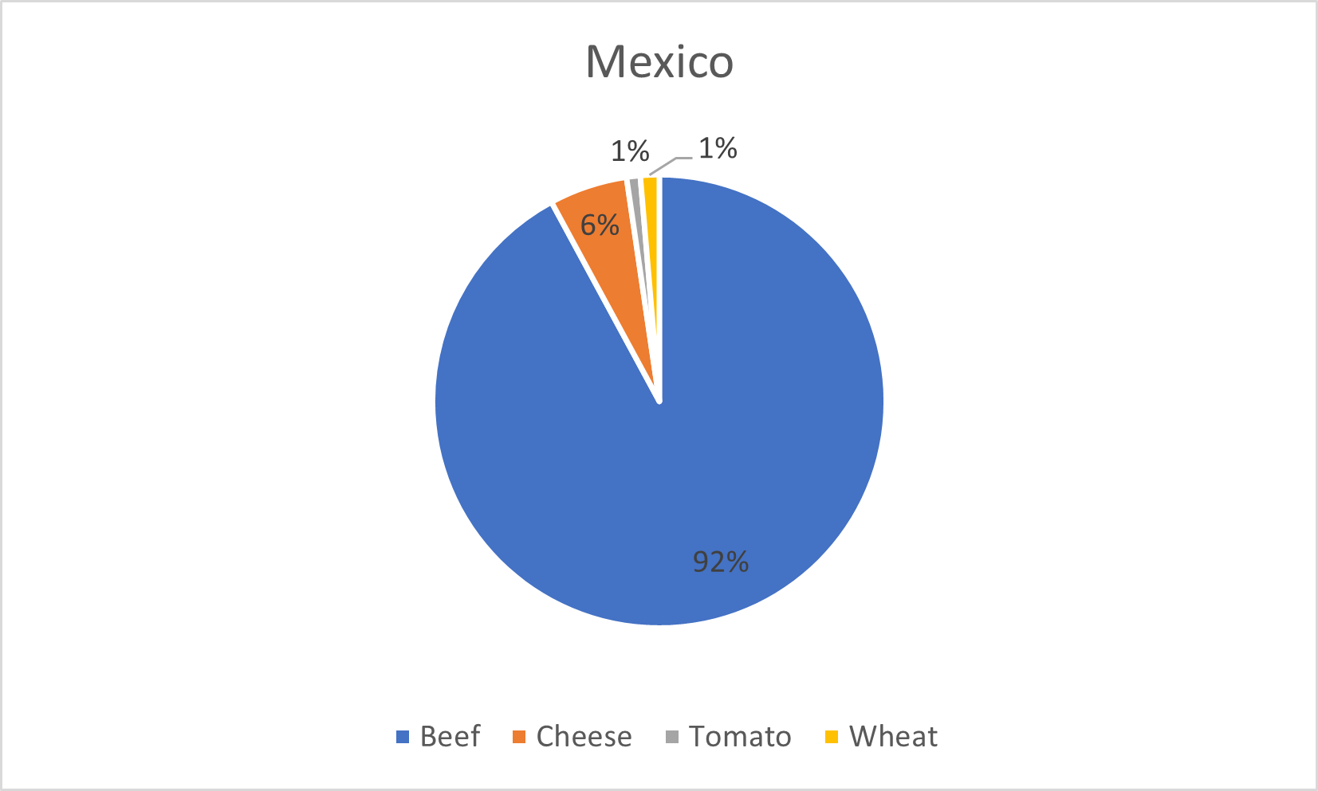
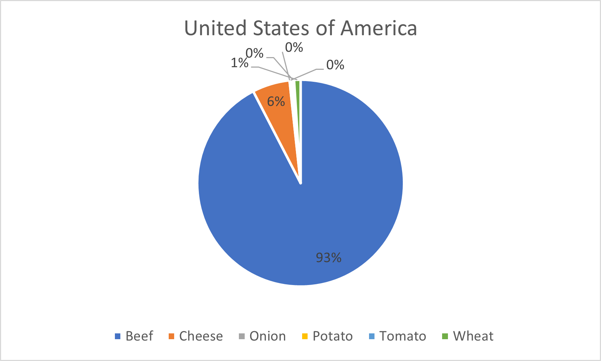
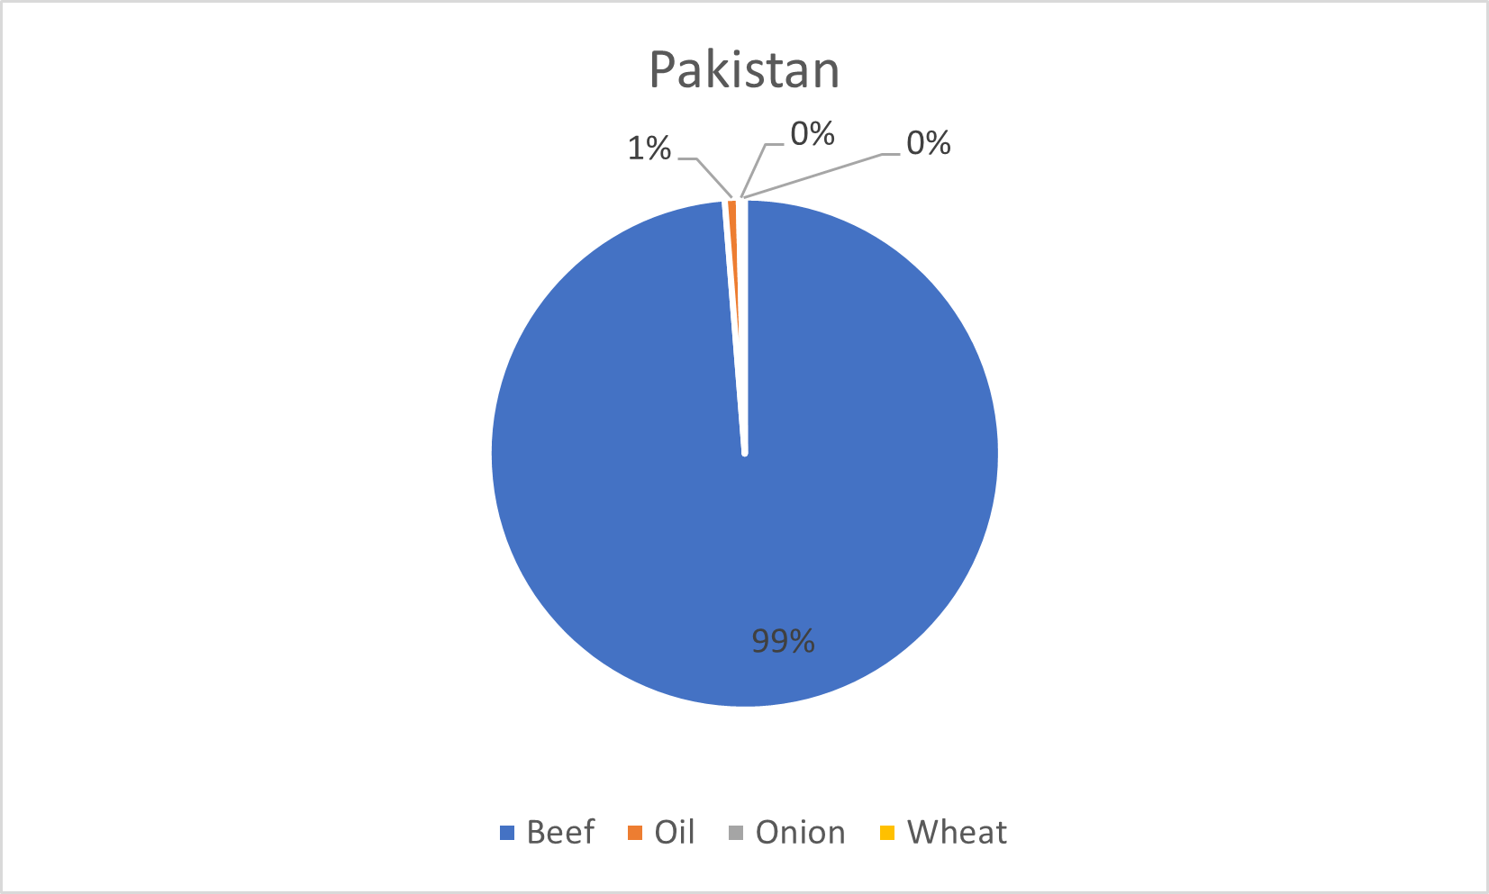
In this plots we can see how Beef takes over the whole region.
The life cycle of beef production, including the growing of feed crops, raising and maintaining the cows, transporting them to slaughter, processing and packaging the meat, and transporting it to retailers and consumers, results in significant emissions of greenhouse gases. The primary sources of emissions are enteric fermentation in cows, manure management, and land use changes associated with feed crop production.

Slide 36
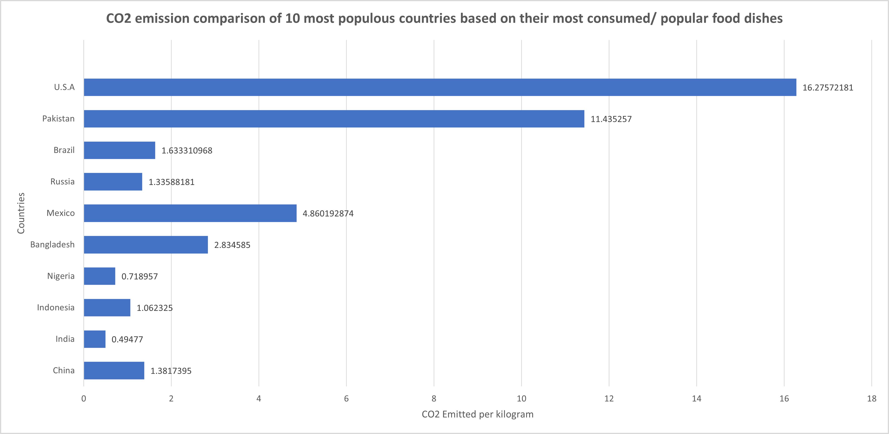
C. Comparison of CO₂ Emission among 10 Countries
The United States, Pakistan, Brazil, and Mexico all have relatively high per capita beef consumption rates, and the production of beef in these countries can contribute to significant emissions of greenhouse gases.
India and Nigeria, have relatively high populations and also traditionally follow mostly a vegetarian diet. This can contribute to lower emissions of greenhouse gases compared to countries with high meat consumption. The production of plant-based foods typically results in lower emissions compared to animal-based foods, due to the fact that animals require more resources, such as water and feed

Slide 37
Conclusion and future scope
7
Final statements of our study and discussion of the scope of work in future

Slide 38
The amount of carbon emissions can be significantly influenced by dietary habits. In comparison to plant-based diets, a diet high in meat, especially red and processed meat, tend to have a higher carbon footprint. A diet that favours seasonal and local foods can assist to increase food security by reducing reliance on imported food and strengthening local food systems.
Future works may involve analysing demographic change that may impact carbon dioxide emissions globally by demonstrating that slower population growth could lead to the emission reductions that are predicted to be required by 2050 to prevent severe climate change. This can be accomplished by applying a food-production growth model that considers a number of demographic parameters.

Slide 39
Citations
IPCC, 2013: Climate Change 2013: The Physical Science Basis. Contribution of Working Group I to the Fifth Assessment Report of the Intergovernmental Panel on Climate Change [Stocker, T.F., D. Qin, G.-K. Plattner, M. Tignor, S.K. Allen, J. Boschung, A. Nauels, Y. Xia, V. Bex and P.M. Midgley (eds.)]. Cambridge University Press, Cambridge, United Kingdom and New York, NY, USA, 1535 pp.
Lacis, A. A., Schmidt, G. A., Rind, D., & Ruedy, R. A. (2010). Atmospheric CO2: Principal control knob governing Earth’s temperature. Science, 330(6002), 356-359.
https://theconversation.com/food-production-generates-more-than-a-third-of-manmade-greenhouse-gas-emissions-a-new-framework-tells-us-how-much-comes-from-crops-countries-and-regions-167623

Slide 40
Thanks!

